Slide 1

Java Programming
Dr.R.Anusuya
Assistant Professor

Slide 2
Concepts
Super constructor()
Super for accessing member
Access rights

Slide 3
super()
super() always refers to the superclass immediately above the calling class.
super() must always be the first statement executed inside a subclass constructor.
If super() is not used in base class constructor, then default constructor of each superclass will be executed.

Slide 4
Why Constructors are not inherited in Java
Constructor is a block of code that allows you to create an object of class and has same name as class with no explicit return type.
Whenever a class (child class) extends another class (parent class), the sub class inherits state and behaviour in the form of variables and methods from its super class but it does not inherit constructor of super class because of following reasons:
  Constructors are special and have same name as class name.
  So if constructors were inherited in child class then child class would contain a parent class constructor which is against the constraint that constructor should have same name as class name.

Slide 5
Now suppose if constructors can be inherited then it will be impossible to achieving encapsulation. Because by using a super class’s constructor we can access/initialize private members of a class.
A constructor cannot be called as a method. It is called when object of the class is created so it does not make sense of creating child class object using parent class constructor notation. i.e. Child c = new Parent();
A parent class constructor is not inherited in child class and this is why super() is added automatically in child class constructor if there is no explicit call to super or this.

Slide 6
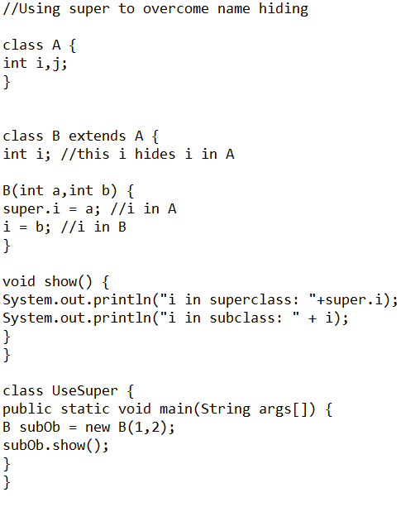
Super for acessing member

Slide 7
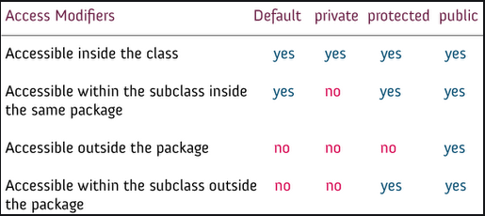
Acess Rights for Different Elements

Slide 8
THANK YOU

